Slide 1

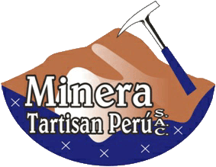
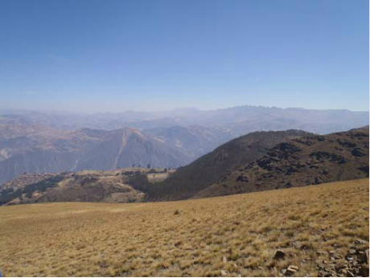
Tartisan Resources Corp.
Exploring Perú’s North-Central Mineral Belt
January 2016

Slide 2
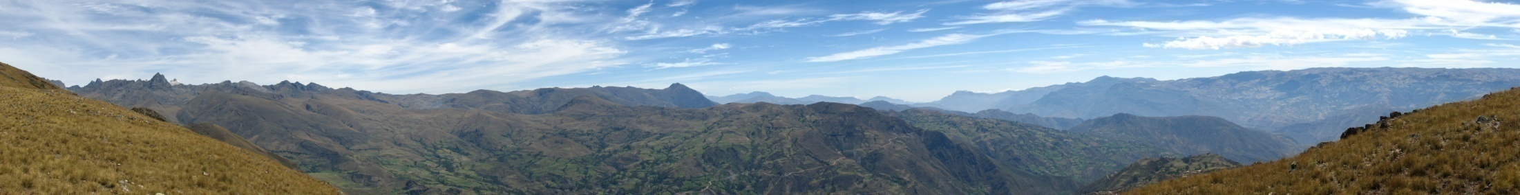
FORWARD LOOKING STATEMENT
This presentation contains “forward-looking statements”. All statements, other than statements of historical fact, that address activities, events, or developments that Tartisan Resources Corp. (“Tartisan” or the “Company”) believes, expects or anticipates will or may occur in the future are forward-looking statements. Forward-looking statements are often, but not always, identified by the use of words such as “seek”, “anticipate”, “believe”, “plan”, “estimate”, “expect”, and “intend” and statements that an event or result “may”, “will”, “can”, “should”, “could”, or “might” occur or be achieved and other similar expressions. These forward-looking statements reflect the current internal projections, expectations or beliefs of Tartisan based on information currently available to Tartisan. Forward-looking statements are subject to a number of risks and uncertainties, including those detailed from time to time in filings made by Tartisan with securities regulatory authorities, that may cause the actual results of Tartisan to differ materially from those discussed in the forward-looking statements, and even if such actual results are realized or substantially realized, there can be no assurance that they will have the expected consequences to, or effects on Tartisan. Tartisan expressly disclaims any obligation to update or revise any such forward-looking statements. As well, this presentation is not intended to be, and should not be construed as, a solicitation of expressions of interest in an investment in the securities of Tartisan.
Not for distribution to United States newswire services and not for dissemination in the United States. The securities discussed herein have not been and will not be registered under the United States Securities Act of 1933 (the “US Securities Act”), as amended, or the securities laws of any state and may not be offered or sold in the United States or to US persons (as defined in Regulation S of the US Securities Act) unless an exemption from registration is available.

Slide 3
Why Tartisan?
  Tartisan Resources Corp.: Listed on the Canadian Securities Exchange (“CSE”) with symbol “TTC”. Began trading September 13, 2012.
  43,634,982 shares issued to date.
  Flagship La Victoria Project in the North-Central Mineral Belt of Perú.
  Eloro Resources Ltd. (TSXV:ELO) has an option to earn-in to 60/40 Joint Venture by funding $1.5 M in exploration work over the next four years (plus $270,000 in cash payments, of which $220,000 has been advanced).
  Geological setting, similar to producing mines in the area, presents excellent potential for epithermal precious-metal and porphyry-style copper mineralization.
  La Republica del Perú has a stable, responsible government with an open door to foreign mining investment and repatriation of those investments.
  Experienced team with the ability to acquire, explore and develop.

Slide 4
Officers and Directors
D. Mark Appleby – President , Chief Executive Officer, Secretary and Director
Dan Fuoco - Chief Financial Officer
Yves P. Clement, P. Geo.- Director
Denis Laviolette – Director, Chairman of the Audit Committee
Douglas Flett, J.D. – Director
INDEPENDENT TECHNICAL ADVISER
Luc Pigeon, P.Geo. (Gateway Solutions, Lima, Perú)

Slide 5
CSE:TTC Share Structure
As of September 15, 2015:
Issued and Outstanding: | 43,634,982*
Options: | NIL¹
Warrants: | 850,000²
Fully Diluted: | 44,484,982
* Management and top six shareholders: >40% of issued and outstanding
1 - Options exercisable @ $0.25 have been cancelled.
2- 850,000 warrants exercisable @ $0.10 and expiring October 01, 2016

Slide 6
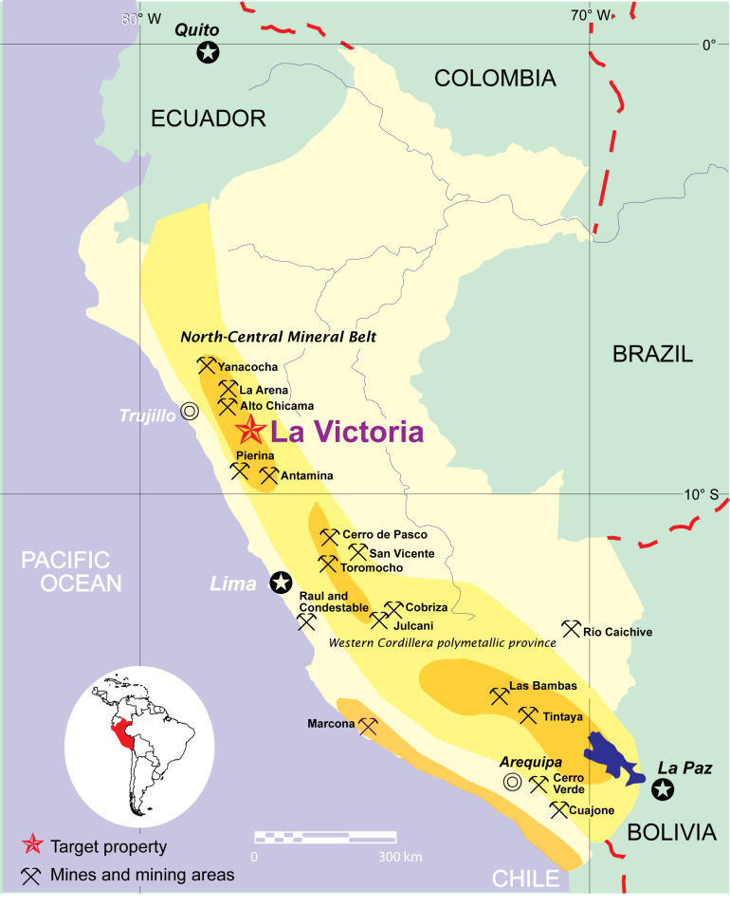
La Victoria Project
Distrito de Huandoval, Pallasca Provincia, Ancash Departmento
In the heart of the Ancash – La Libertad mining area in the North-Central Mineral Belt of Perú.
425 km N of Lima, 120 km E of Trujillo at 3,100 m to 4,200 m elevation.
100% ownership in eight mining concessions covering 3,360 ha. Eloro has an option to earn-in to a 60% interest and JV.
Three current target areas:
San Markito –Victoria (Ag > Au)
Rufina (Au ≈ Ag)
Ccori Orcco (Ag, ±Cu)
Over $800,000 in exploration expenses by Tartisan to date.

Slide 7
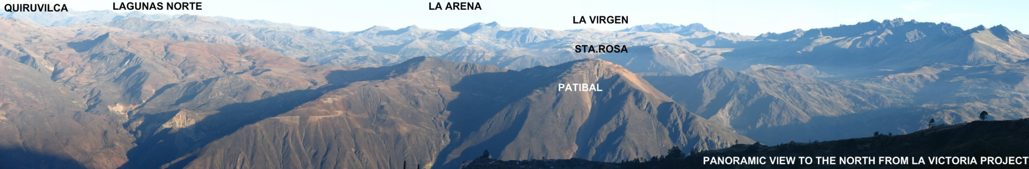
Gold Producers
North-Central Mineral Belt, Perú
Mine | Company | Gold Production 2014 | Elevation ASL (m) | Distance From La Victoria
Yanacocha | Newmont/Buenaventura | 15.6 t | 3,500 - 4,500 | 160 km NNW
Lagunas Norte | Barrick | 18.2 t | 3,700 - 4,200 | 50 km NW
Quiruvilca | Pan American (Southern Peaks) | 112.5 t Ag | 3,800 | 50 km NW
La Arena | Rio Alto | 6.9 t | 3,800 – 4,100 | 50 km NW
Retamas | MARSA | 5.5 t est. | 2,500 – 3,200 | 60 km E
Parcoy | Consorcio Minero Horizonte S.A. | 5.7 t est. | 2,600 – 3,000 | 60 km E
Santa Rosa | COMARSA | 5 t est. | 3,300 - 4,000 | 20 km NNW
Poderosa | Cia. Minera Poderosa S.A. | 2 t est. | 2,500 | 75 km NNE
La Virgen | Cia. Minera San Simon S.A. | 0.6 t est. | 3,500 - 3,900 | 35 km NNW
Patibal | S.M.R.L. El Rosario de Belen | 0.4 t est. | 4,100 | 15 km NW

Slide 8
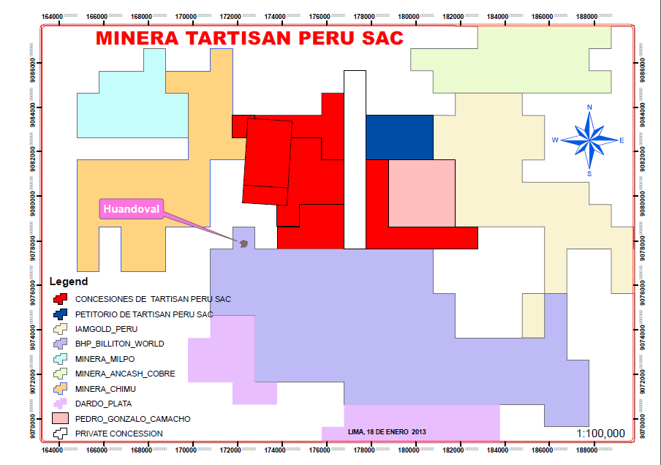
La Victoria Concessions
  Neighbour holdings recently acquired and/or expanded by BHPB, IAMGOLD and others.
  High interest (including Barrick) in concession to remate (auction).
  Concession intervening Tartisan properties has been claimed by Tartisan and title is pending.
Remate
IAMGOLD
Peru
BHP
Billiton

Slide 9
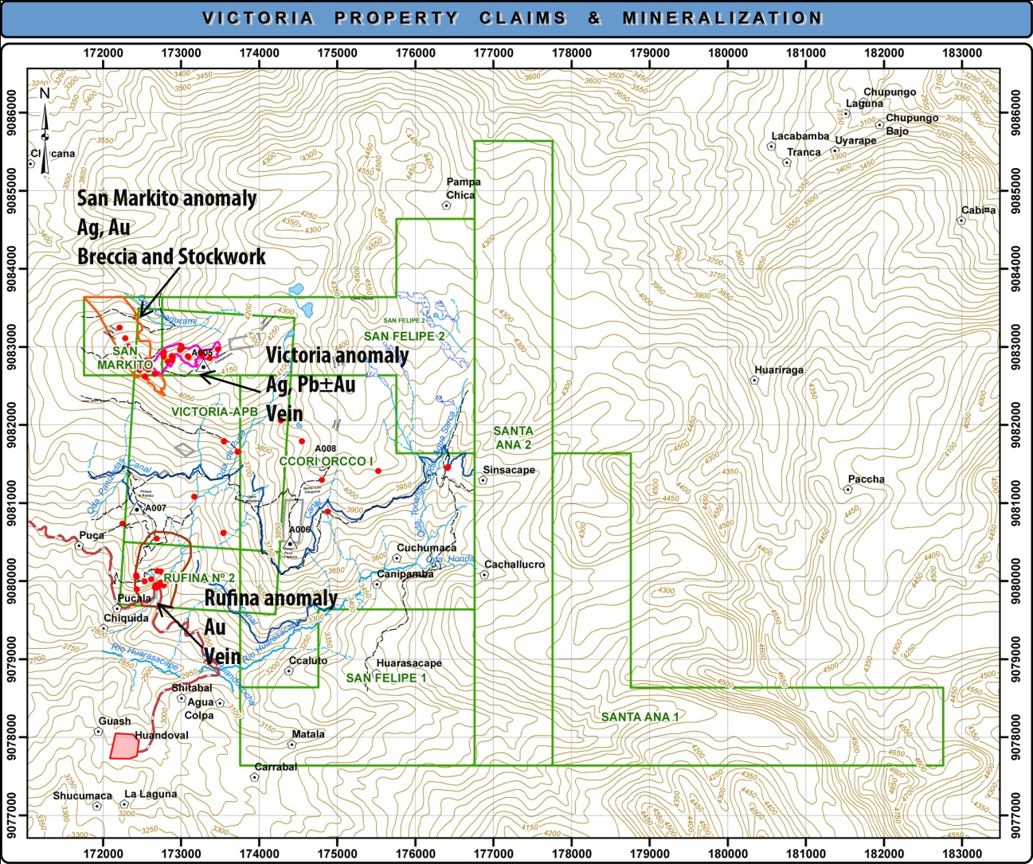
La Victoria Exploration Work
  Constructed 10-km long access road to San Markito zone
  Topographic survey with geodesic benchmarks
  Magnetic survey – 125 line km
  IP survey – 34 line km
  Spectral analysis study
  Rock sampling (600+ samples submitted for multi-element analysis)
  Preparation of an NI 43-101-compliant technical report
  Good CSR track record

Slide 10
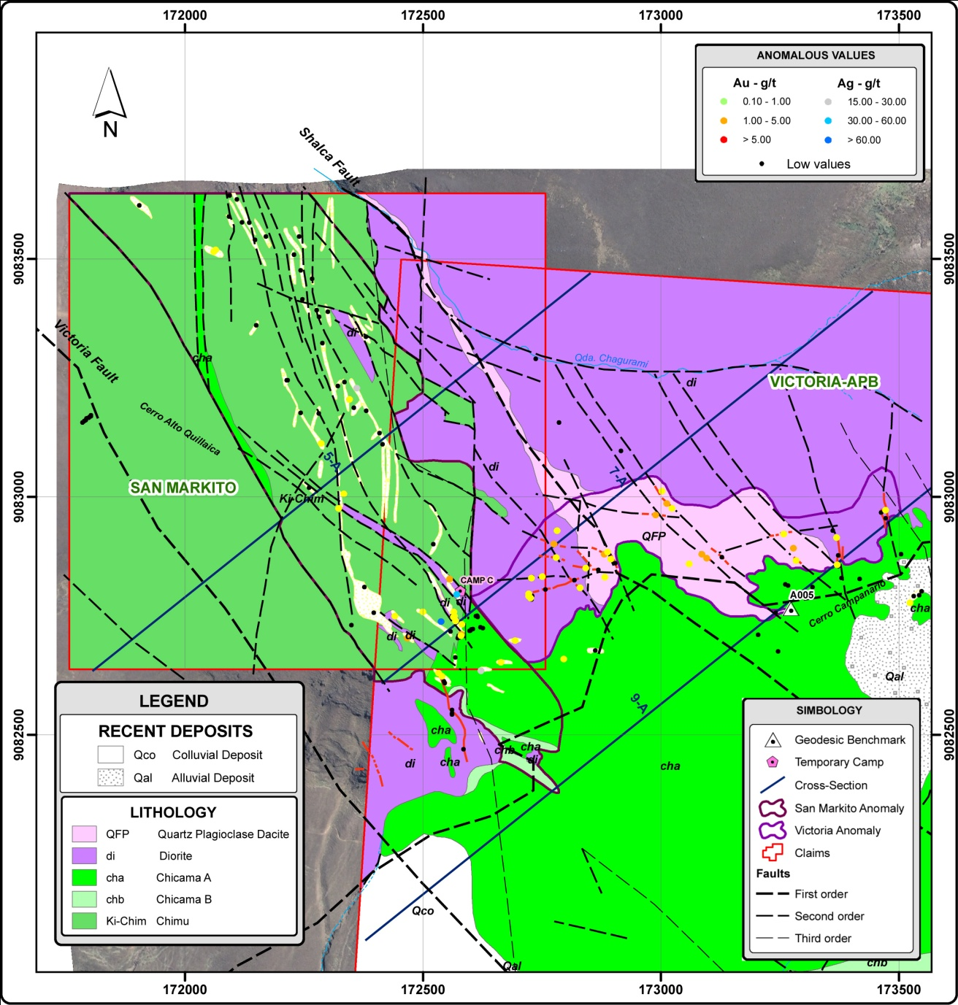
SAN MARKITO - VICTORIA
Silicified Chimu sandstones at contact with Diorite and QFP intrusives.
Total of15 NW-trending structures identified within 1,300 m x 400 m zone: hydrothermal breccia and stockwork quartz-iron oxide veins.
Ag>Au with associated Pb, As, Sb. Up to 1,814 g Ag/t, 2.273 g Au/t reported in grab samples.
November 2013, 6 samples returned up to 259 g Ag/t.
Diorite
Chimu
QFP

Slide 11
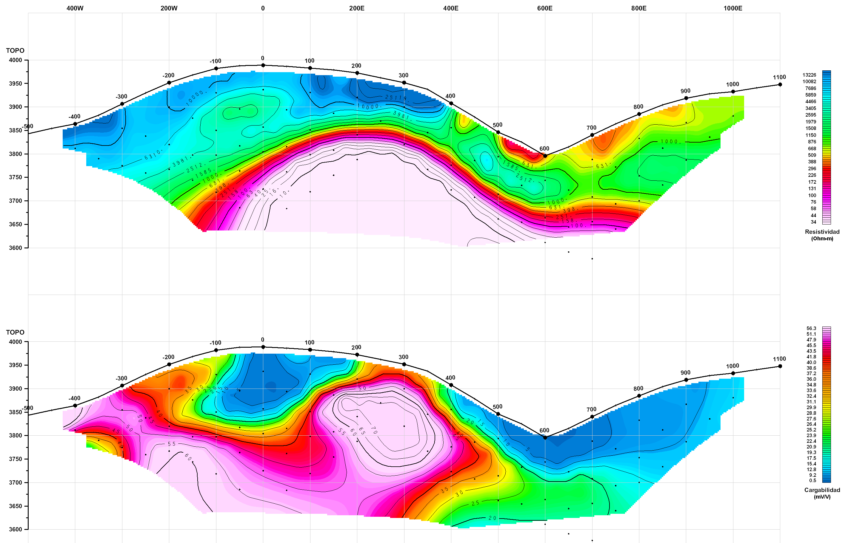
SAN MARKITO - VICTORIA
IP chargeability target coincident with breccia/stockwork zone at San Markito (L 1425 N shown)

Slide 12
SAN MARKITO - VICTORIA
E-W trending zone with Ag>Au and associated Cu, W, Mo (±Pb, As). Located east of San Markito zone.
Within QFP and Diorite intrusives at or near sedimentary contact.
Total of 13 vein structures identified within 1000 m x 175 m zone.
Grab samples report up to 927 g Ag/t and 4.296 g Au/t.
Diorite
Chimu
QFP

Slide 13
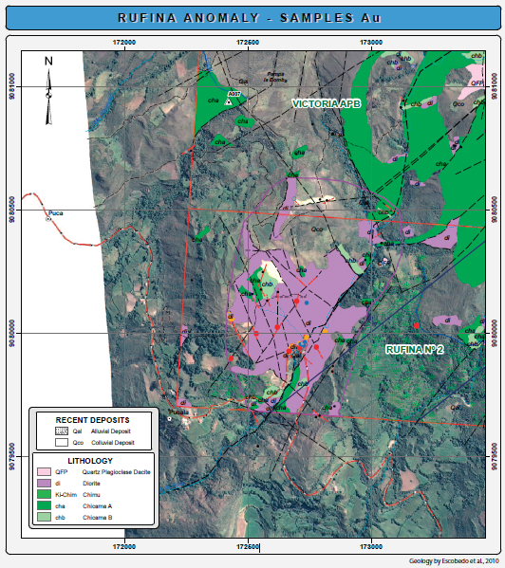
RUFINA
NNE-trending zone exhibiting Au≈Ag and As (±Cu, Mo, Sb).
Localized within Diorite intrusive.
Total of nine vein structures identified within 1000 m x 500 m zone.
Up to 46.47 g Au/t and 95.2 g Ag/t reported in grab samples.
Diorite
Chimu
QFP

Slide 14
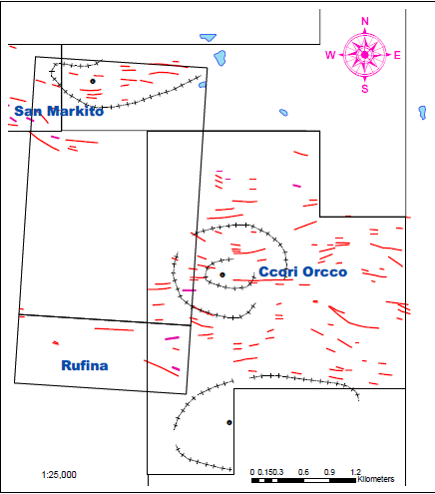
CCORI ORCCO
Ccori Orcco multi-phase intrusion similar to Victoria, as interpreted from magnetic survey.
Possible porphyry-copper style exploration target.
Anomalous Ag values associated with intrusive.

Slide 15
Conceptual Models
RUFINA
SAN MARKITO
VICTORIA
CCORI ORCCO
After Corbett, 2007: Cotrols to iow Sulphidation epithermal Au-Ag mineralization

Slide 16
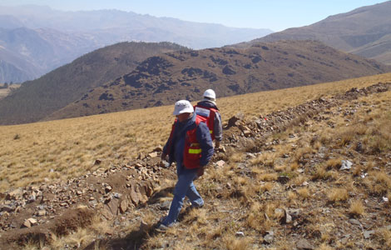
La Victoria Project
Exploration
    Eloro option to fund exploration work over the next four years: Yr 1 - $250,000; Yr 2 - $350,000; Yr 3 - $400,000; and Yr 4 - $500,000. Total: $1.5 M.
    Tartisan is project operator, overseen by joint exploration committee of Tartisan (1member) and Eloro (2 members).
    Phase 1: Drill program (min. 1,000 m) to test San Markito IP target.
    Follow-up exploration phases to test other known parts of the property area.
    Secondary raise by Tartisan for:
      corporate administration
      land acquisition, environmental studies, CSR
      examination of unexplored areas of property
      To acquire opportunistic available properties and projects in Peru and Ontario/Quebec with a view to unlocking value while awaiting improving market conditions.

Slide 17
Why Tartisan?
  Flagship La Victoria Project in the North-Central Mineral Belt of Perú.
  Exploration funding to be provided by Eloro Resources Ltd.: option to earn-in to 60/40 Joint Venture by funding $1.5 M in exploration over the next four years.
  Geological setting, similar to producing mines in the area, presents excellent potential for epithermal precious-metal and porphyry-style copper mineralization.
  La Republica del Perú has a stable, responsible government with an open door to foreign mining investment and repatriation of those investments.
  Experienced team with the ability to acquire, explore and develop. In particular, potential land bank properties under assessment.
  43,634,982 shares issued to date.

Slide 18
TARTISAN RESOURCES CORP.
Contact Us
D. Mark Appleby
President, Chief Executive Officer and Director
Tel: +1 (416) 804-0280
mark@tartisanresources.com
Suite 710, 44 Victoria Street,
Toronto, Ontario, Canada, M5C 1Y2
http://tartisanresources.com
info@tartisanresources.com
CSE:TTC

Slide 19
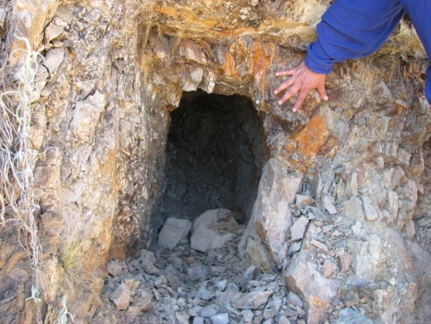
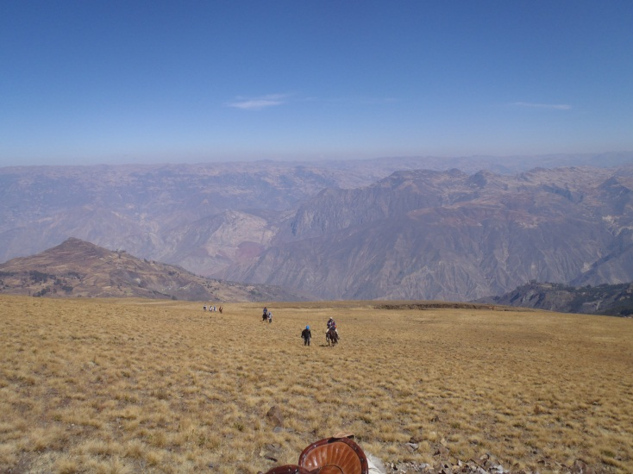
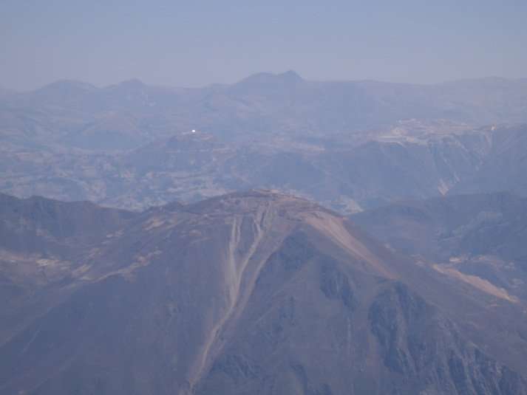
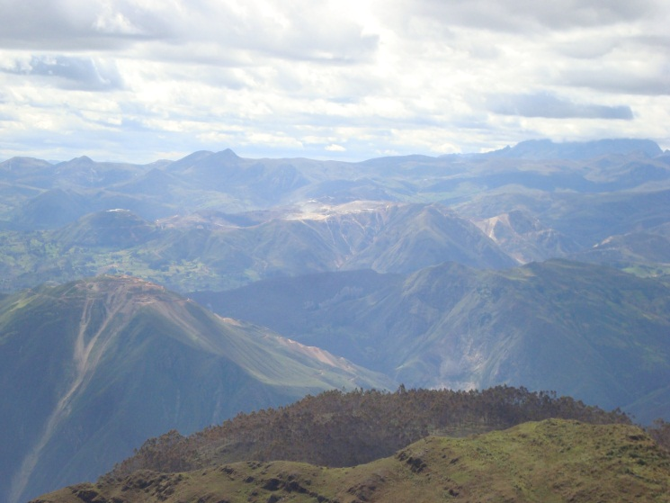
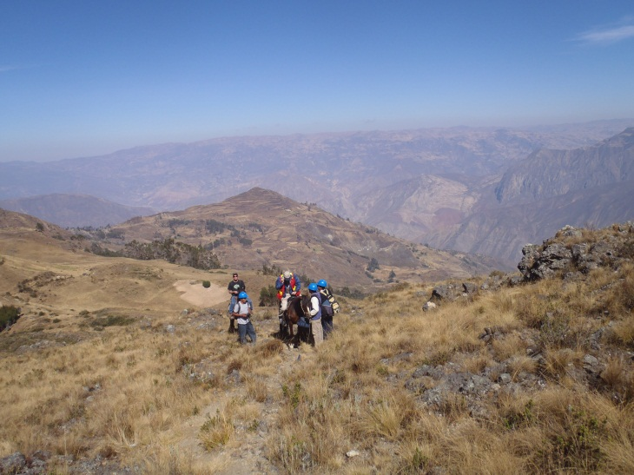
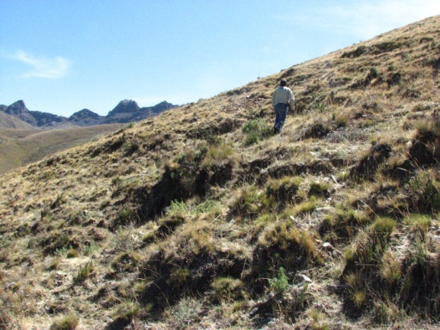
La Victoria Project
Photo Gallery

Slide 20
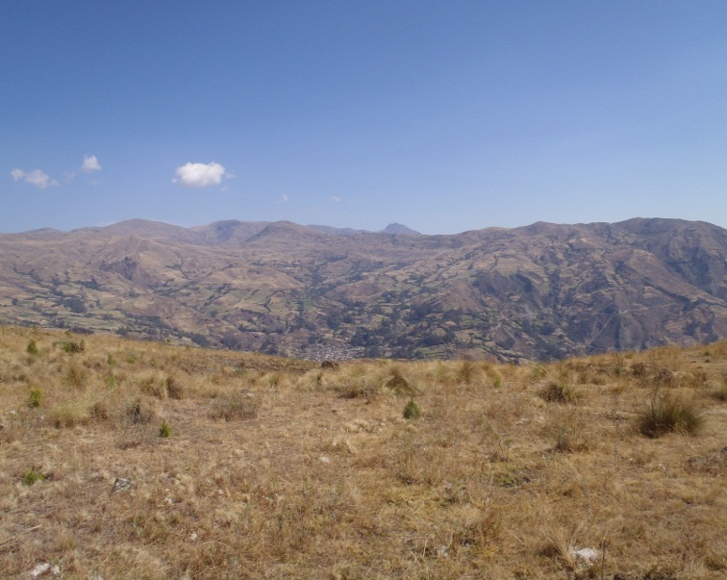
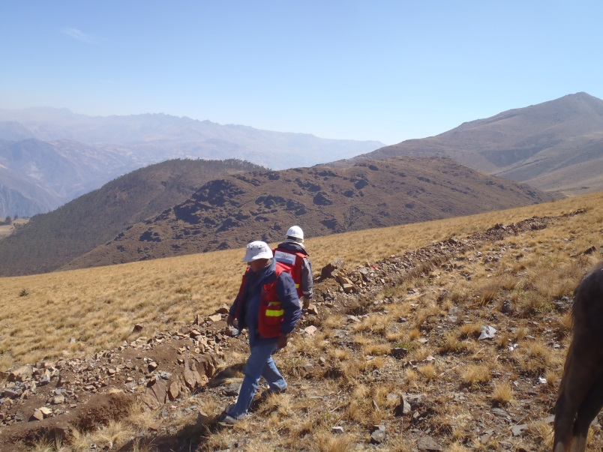
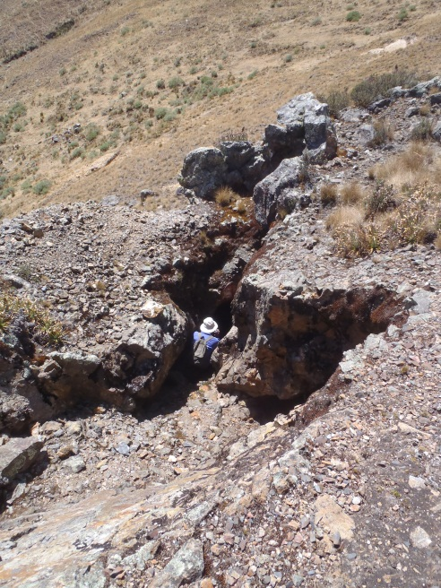
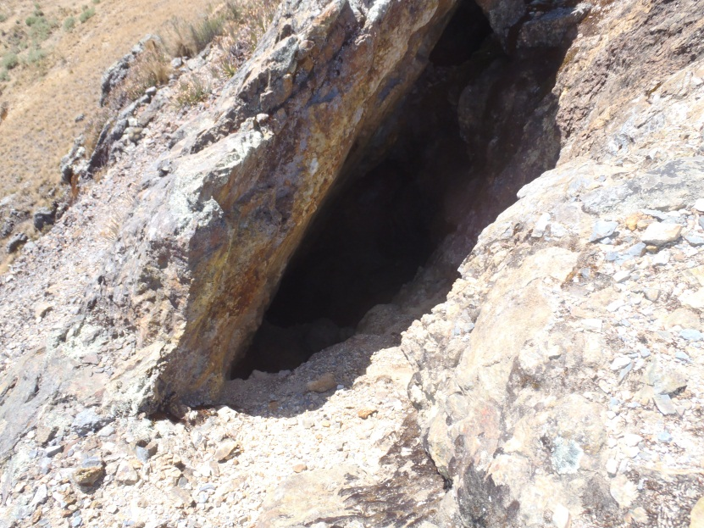
La Victoria Project
Photo Gallery

Slide 21
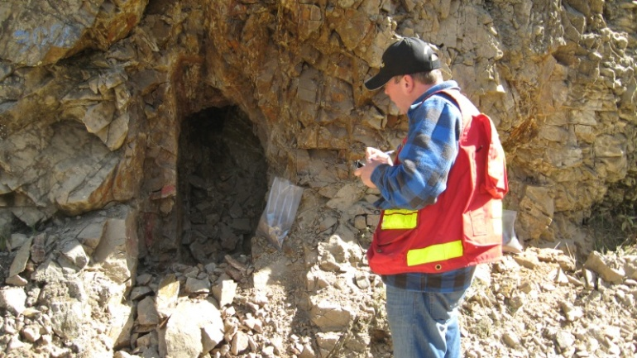
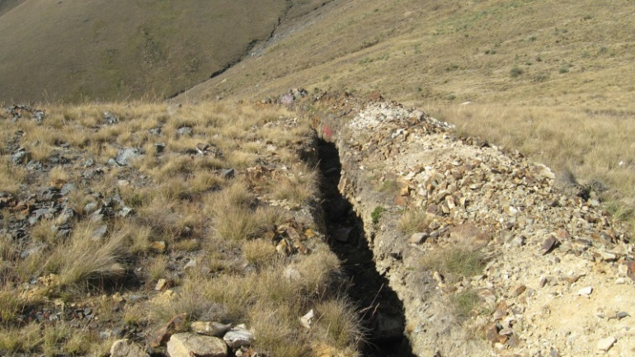
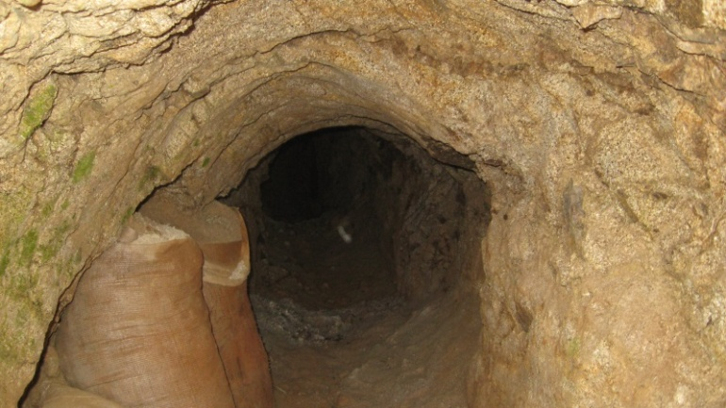
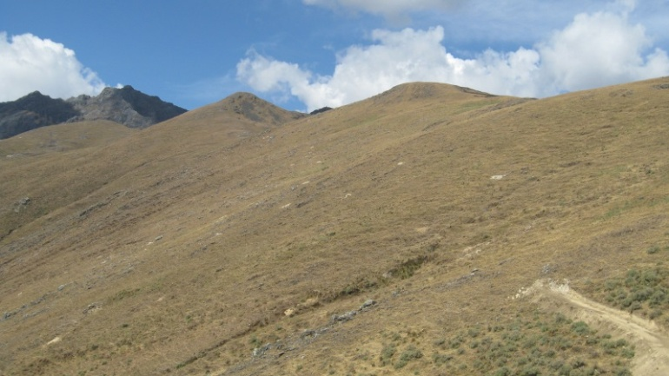
La Victoria Project
Photo Gallery

